Slide 1

8th Semester
Major Project Presentation
on
Image Based Cattle Measurement and Trait Estimation System
Presented by
Sriya Padhy ( Regd. No. : 22UG010750 )
Tina Begum ( Regd. No. : 22UG010911 )
Under the guidance of
Mr. V. S. K. Chaitanya
Assistant Professor, Department of CSE, GIET University
Gandhi Institute of Engineering and Technology University
April 2026

Slide 2

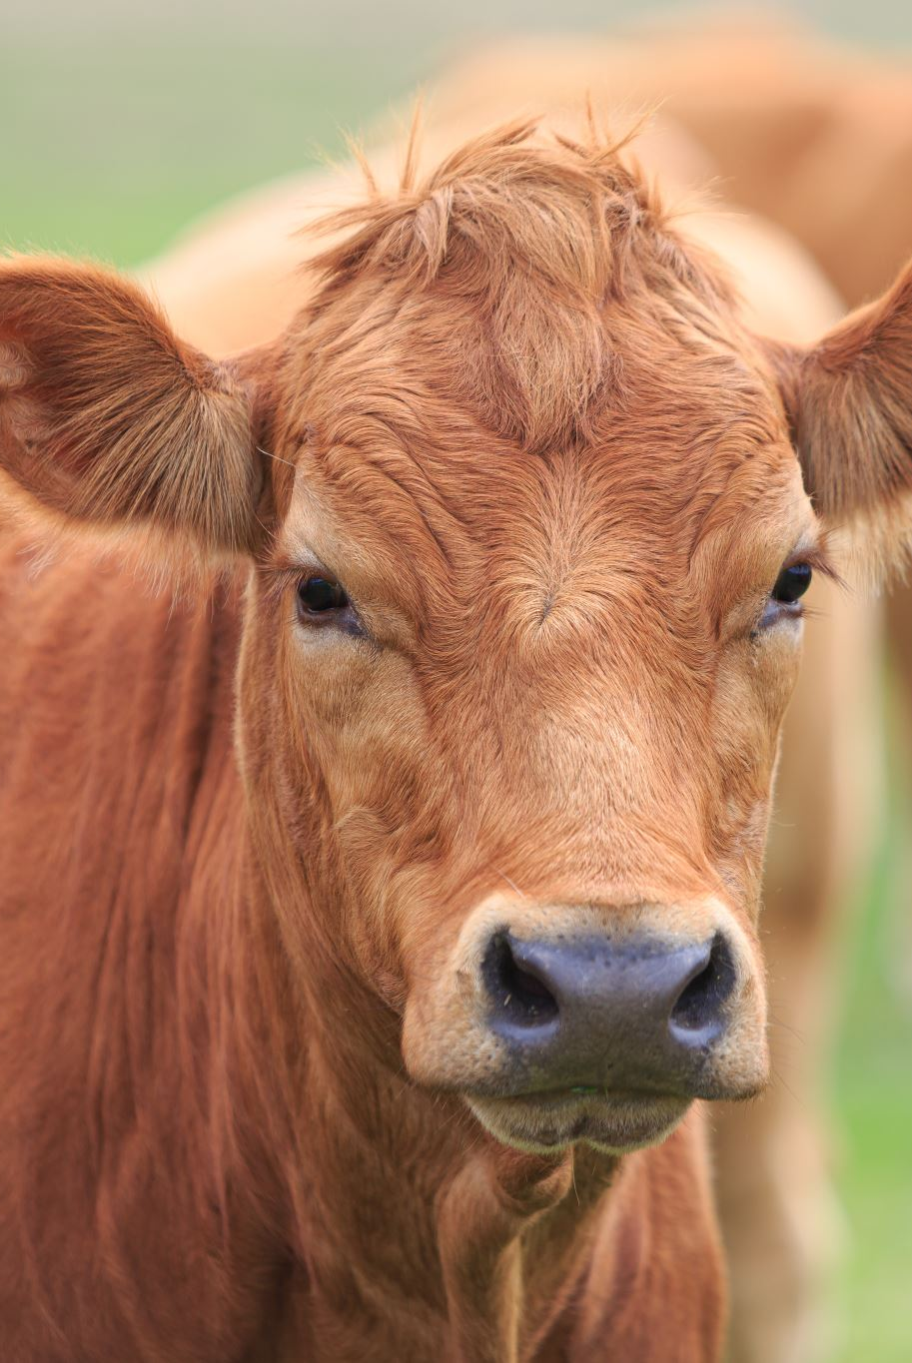
Problem Statement
A Project Presentation on
“Image Based Cattle Measurement and Trait Estimation System“
Animal Type Classification (ATC) is traditionally performed manually by trained experts
The process is subjective, time-consuming, and prone to human error
Inconsistent evaluations affect breeding decisions and productivity
Existing AI methods focus only on detection or measurement
They do not provide standardized ATC scoring
Hence there is a need for an automated, image-based system for objective ATC scoring.

Slide 3
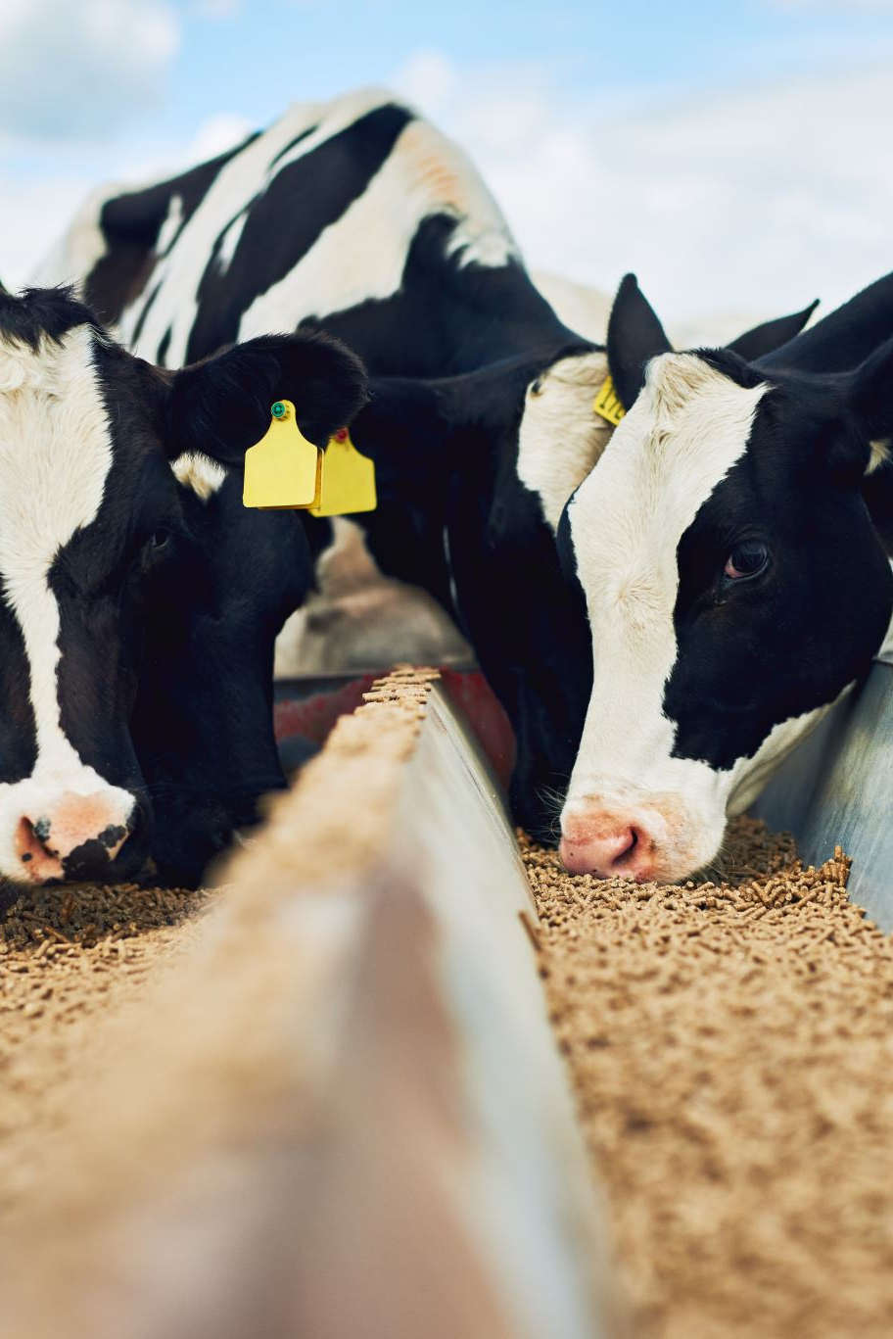
Objectives
A Project Presentation on
“Image Based Cattle Measurement and Trait Estimation System“
The primary objectives of this project are:
To automate the Animal Type Classification process for cattle using AI and image processing.
To reduce subjectivity, bias, and human error present in manual ATC methods.
To accurately detect anatomical landmarks and extract key body structure parameters.
To generate standardized and reproducible ATC scores.
To support scientific decision-making in breeding programs .

Slide 4
Literature Review
Category | Paper / Study | Year | Technique Used | Dataset Type | Measurements Extracted | ATC Scoring | Limitations
Pose Estimation | Huang et al. [2] – Multicow Pose Estimation for Dairy Monitoring | 2022 | Pose estimation | Farm cattle images | Keypoints | No | No structural scoring
 | Wu et al. [11] – Consistent Multi-Animal Pose Estimation in Cattle | 2025 | Pose + tracking | Farm cattle images | Keypoints | No | Focuses on detection only
Measurement Estimation | Peng et al. [7] – Automated Measurement Using Keypoints + Depth | 2024 | YOLOv8 + depth | RGB + Depth | Body dimensions | No | Requires depth camera
 | Yue et al. [13] – Cattle Measurement using YOLOv8 + 3D Point Cloud | 2024 | YOLOv8 + 3D | RGB + 3D | Body measurements | No | Requires specialized setup
Lightweight / Efficient Models | Li et al. [4] – Lightweight Cattle Pose Estimation with Attention | 2024 | Lightweight pose model | Cattle pose dataset | Keypoints | No | Limited structural analysis
Application-Based | Song et al. [9] – Lameness Scoring using Keypoints | 2023 | Pose + ML | RGB Images | Lameness score | No | Not for conformation
Existing works mainly focus on detection, measurement, or specific applications like lameness detection.

Slide 5
Research Gap
Existing methods mainly focus on keypoint detection or measurement extraction, not structural evaluation
Most systems do not convert measurements into standardized ATC scores
Several approaches depend on depth cameras or multi-view setups, limiting real-world use
There is no end-to-end system combining detection, measurement, and scoring
Limited focus on practical farm-level deployment using RGB images
This gap motivates the development of an automated image-based ATC scoring system.

Slide 6
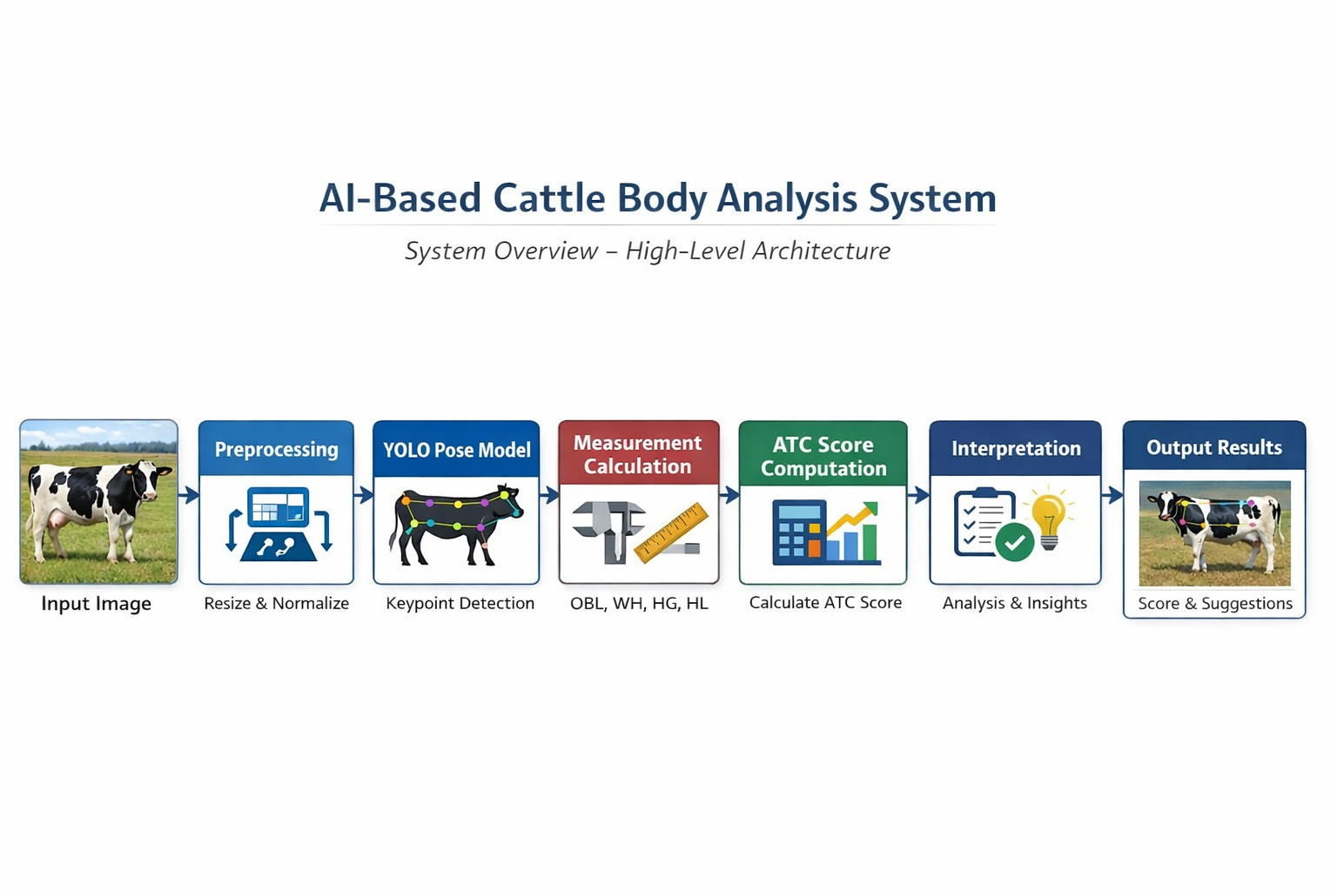
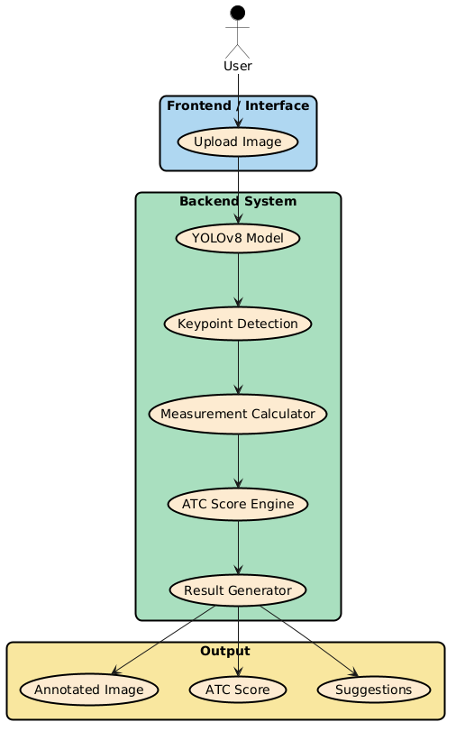
Methodology Or Proposed Work
SYSTEM OVERVIEW
Input: Side-view cattle image
Keypoint Detection : YOLOv8-Pose detects anatomical keypoints
Measurement Extraction : Geometric measurements are computed from keypoints
Ratio Normalization : Measurements are normalized using withers height
ATC Scoring : Normalized ratios are converted into ATC scores
This forms a complete end-to-end ATC scoring pipeline.
SYSTEM ARCHITECTURE DIAGRAM

Slide 7
Implementation
( Tools & Technologies )
Python - Used as the primary programming language for implementing the entire system
PyTorch - Used for building and running the deep learning model (YOLOv8-Pose)
YOLOv8 (Ultralytics) - Used for detecting anatomical keypoints from cattle images
OpenCV - Used for image processing and visualization of detected keypoints
NumPy - Used for numerical computations such as distance calculation and ratio normalization
Google Colab (GPU) - Used for training and testing the model with GPU acceleration
Gradio (Frontend) - Used to create a user-friendly interface for uploading images and displaying results

Slide 8
A Project Presentation on
“Image Based Cattle Measurement and Trait Estimation System“
YOLOv8-Pose detects 26 anatomical landmarks
Distances between keypoints are calculated
Key ratios computed: OBL/WH, HG/WH, HL/WH
Ratios are mapped to predefined scoring ranges
Final ATC score is generated and categorized
The ATC score is interpreted and suggestions are provided
Implementation
(Model & Logic)

Slide 9
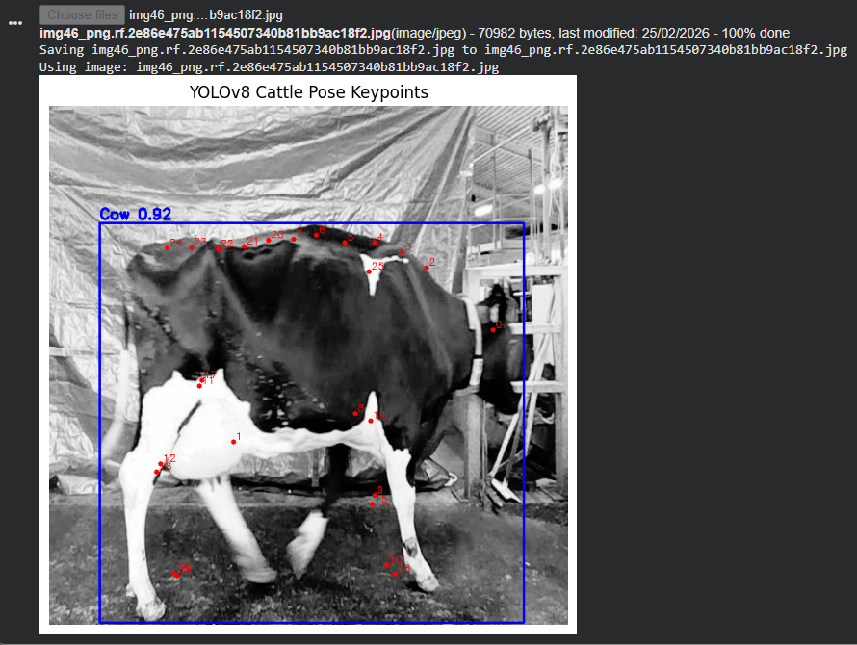
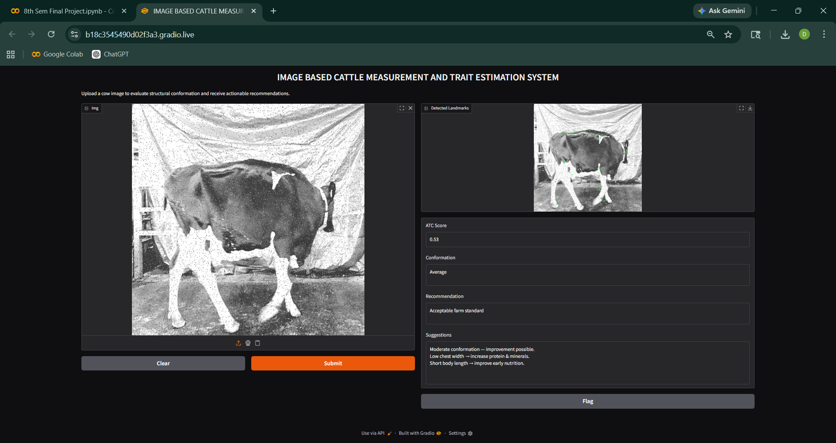
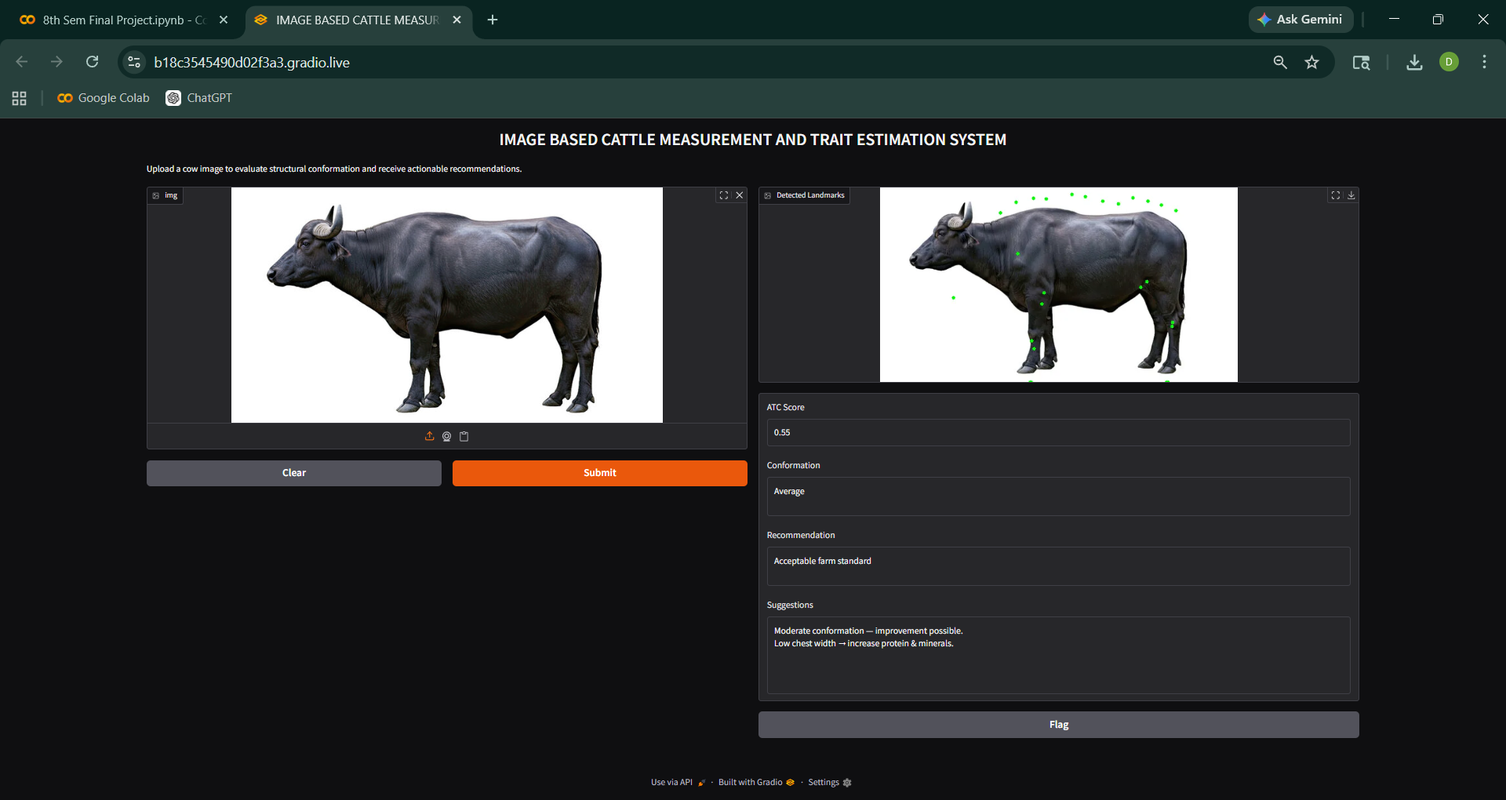
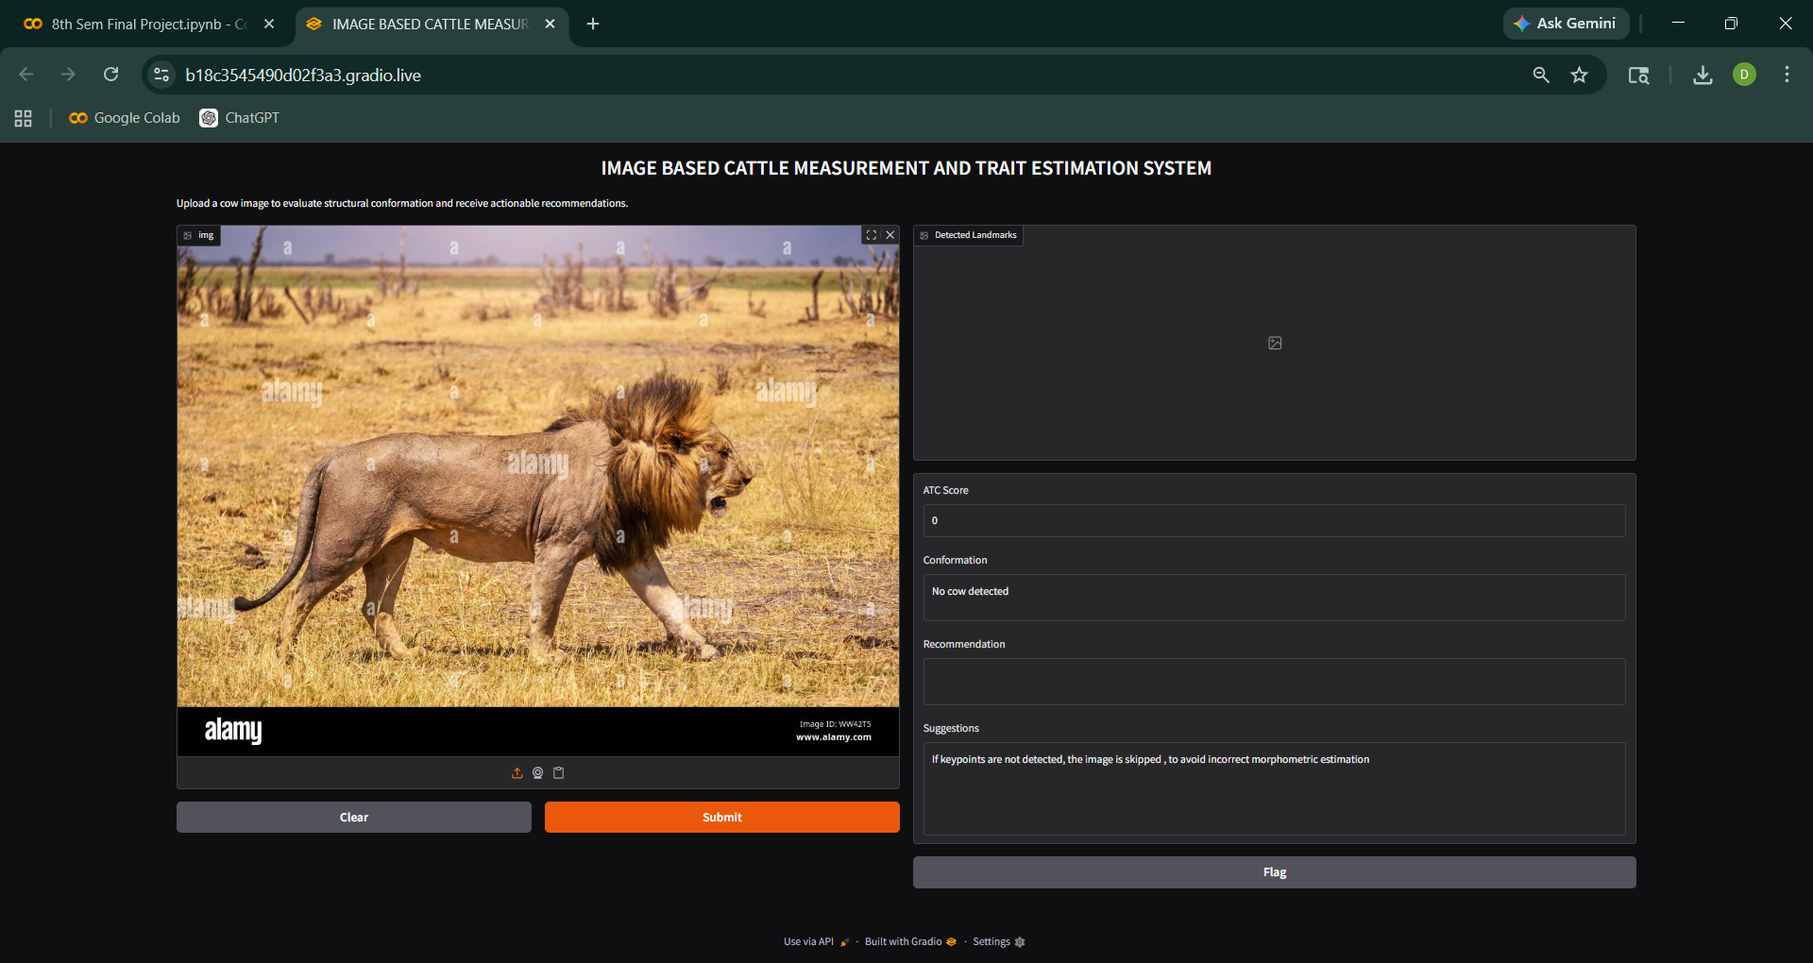
Results
A Project Presentation on
“Image Based Cattle Measurement and Trait Estimation System“
Landmark Detection
Output - 1
Output - 2
Output - 3

Slide 10
Results ( Cont..)
A Project Presentation on
“Image Based Cattle Measurement and Trait Estimation System“
The system generates an ATC score (0–1) for each cattle image
Eg. : ATC Score: 0.53 (GOOD)
The score is mapped to categories:
Poor / Average / Good / Excellent
The system also provides recommendations and suggestions
The output is displayed through a Gradio interface, making it easy for users to upload images and view results instantly
The system performs fast inference, enabling near real-time evaluation in practical scenarios
The system performs a completely automated and non-invasive evaluation

Slide 11
Discussion
A Project Presentation on
“Image Based Cattle Measurement and Trait Estimation System“
Challenges Faced
Pose variation and occlusion affect keypoint detection
Limited dataset diversity
Measurement accuracy depends on landmark precision
Solutions Applied
Used YOLOv8-Pose for robust detection
Applied ratio normalization for consistency
Trained on diverse dataset conditions
The key contribution is the conversion of geometric measurements into standardized ATC scores using an automated pipeline.
Unlike existing methods, our system bridges the gap between measurement and standardized ATC scoring.

Slide 12
Future Work
A Project Presentation on
“Image Based Cattle Measurement and Trait Estimation System“
Multi-view or 3D analysis Integrating multiple camera views or depth information to improve accuracy of structural measurements
Larger and more diverse dataset Expanding the dataset with different cattle breeds, ages, and farm conditions to improve model generalization
Mobile application development Developing a mobile-based interface for easy use by farmers in real-time field conditions
Expert-based ATC calibration Aligning the scoring system with expert evaluations to improve reliability and practical acceptance

Slide 13
Conclusion
A Project Presentation on
“Image Based Cattle Measurement and Trait Estimation System“
Successfully developed an automated image-based ATC scoring system for cattle
The system uses YOLOv8-Pose to detect anatomical landmarks and compute structural measurements
Converts measurements into standardized ATC scores, reducing dependency on manual evaluation
Provides consistent, objective, and non-invasive assessment using only RGB images
The system is practical for real-world farm environments and supports data-driven decision making
It enables scalable, data-driven cattle evaluation for real-world applications.

Slide 14
References
[1] H. Chen et al., “Livestock biometrics via computer vision: A review,” Animals, 2024.
[2] J. Huang et al., “Multicow pose estimation for dairy monitoring,” PLOS ONE, vol. 17, no. 6, 2022.
[3] A. Kumar et al., “Deep learning for visual animal monitoring: A review,” 2023.
[4] Y. Li et al., “Lightweight cattle pose estimation with attention mechanism,” 2024.
[5] W. Ma et al., “Computer vision-based measurement techniques for livestock body dimension and weight: A review,” Agriculture, 2024.
[6] W. Ma et al., “Computer-vision-based sensing technologies for livestock body dimension measurement: A survey,” Sensors, 2024.
[7] C. Peng et al., “Automated measurement of cattle dimensions using improved keypoint detection combined with unilateral depth imaging,” Animals, 2024.
[8] H. Russello et al., “T-LEAP: Occlusion-robust pose estimation of walking cows using temporal information,” 2021.
[9] S. Song et al., “Deep learning lameness scoring in dairy cattle using keypoints,” 2023.
[10] S. Wang et al., “Lightweight automatic cattle body measurement method based on keypoint detection,” 2024.
[11] Z. Wu et al., “Consistent multi-animal pose estimation in cattle,” 2025.
[12] Z. Wu et al., “Multi-view fusion-based automated full-posture cattle body size measurement,” Animals, 2024.
[13] C. Yue et al., “Automatic and accurate measurement of cattle body based on a lightweight YOLOv8-pose model and 3D point cloud,” 2024.
[14] C. Yue et al., “Automatic and accurate measurement of cattle body based on lightweight YOLOv8-pose,” 2024.
[15] Z. Zhang et al., “Multi-cattle lameness detection via pose estimation and machine learning,” Scientific Reports, 2023.

